Slide 1
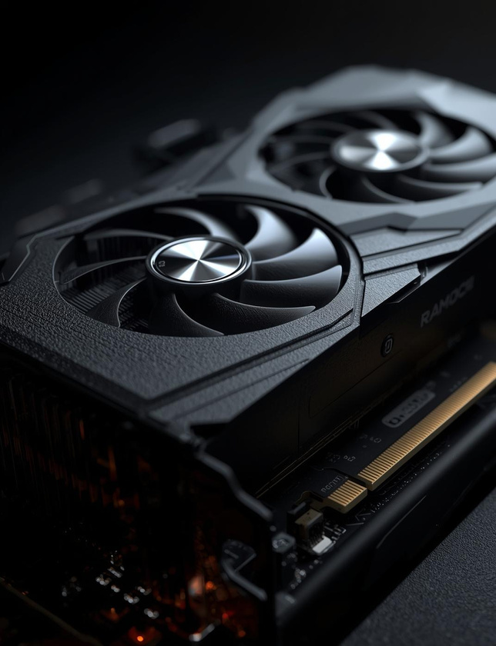


GPU
ACCELERATE
IMAGE CLASSIFICATION
DEEP LEARNING MODEL
SHISHIR & RICARDO

Slide 2
Overview
Built a fully parallel CNN for image classification
CUDA kernels: Normalize, Convolution, Pooling, Dense, Loss, Adam
Optimized performance with:
Shared Memory
Tiled Convolution
1024 thread Dense reduction
Classified images from the Cats vs Dogs dataset
Computed training and testing accuracy directly on GPU
Generated epochwise GPU kernel time summaries to analyze performance

Slide 3
Dataset & Processing
Dataset
Cats vs Dogs dataset (25,000 images)
Loaded from two folders:
PetImages/Cat/ → label 0
PetImages/Dog/ → label 1
Split: 80% training, 20% testing
Image Preparation
Converted every image to 150 × 150 grayscale
Copied to GPU for preprocessing

Slide 4
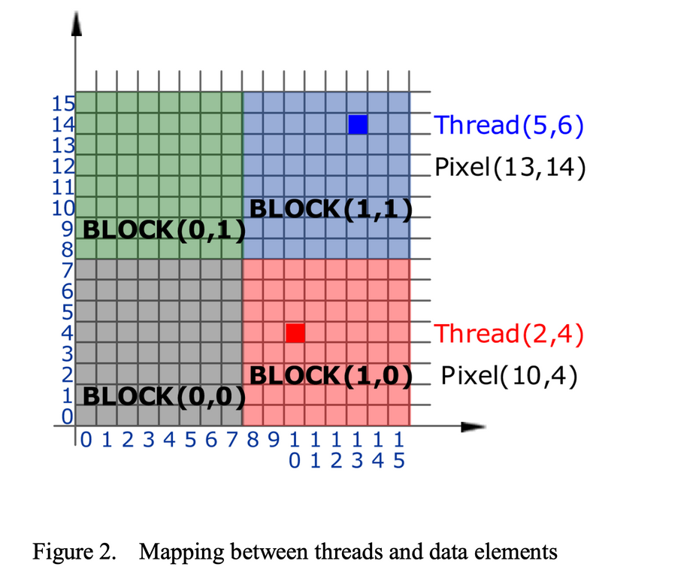
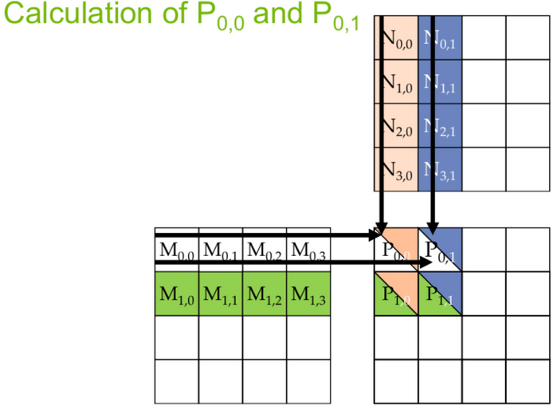
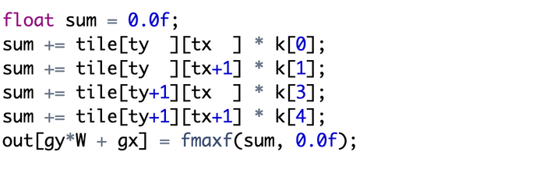
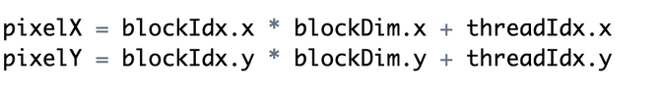
Global vs Shared Memory
Pixel Position:
Blue example
Thread = (5,6) in block (1,1)
Pixel = (13,14) in the global image
Red example
Thread = (2,4) in block (1,0)
Pixel = (10,4) in the global image
Each thread matches to one pixel
tile[ty ][tx ] → current pixel
tile[ty ][tx+1] → pixel to the RIGHT
tile[ty+1][tx ] → pixel BELOW
tile[ty+1][tx+1] → pixel DIAGONALLY DOWN RIGHT
Pixel*filters

Slide 5
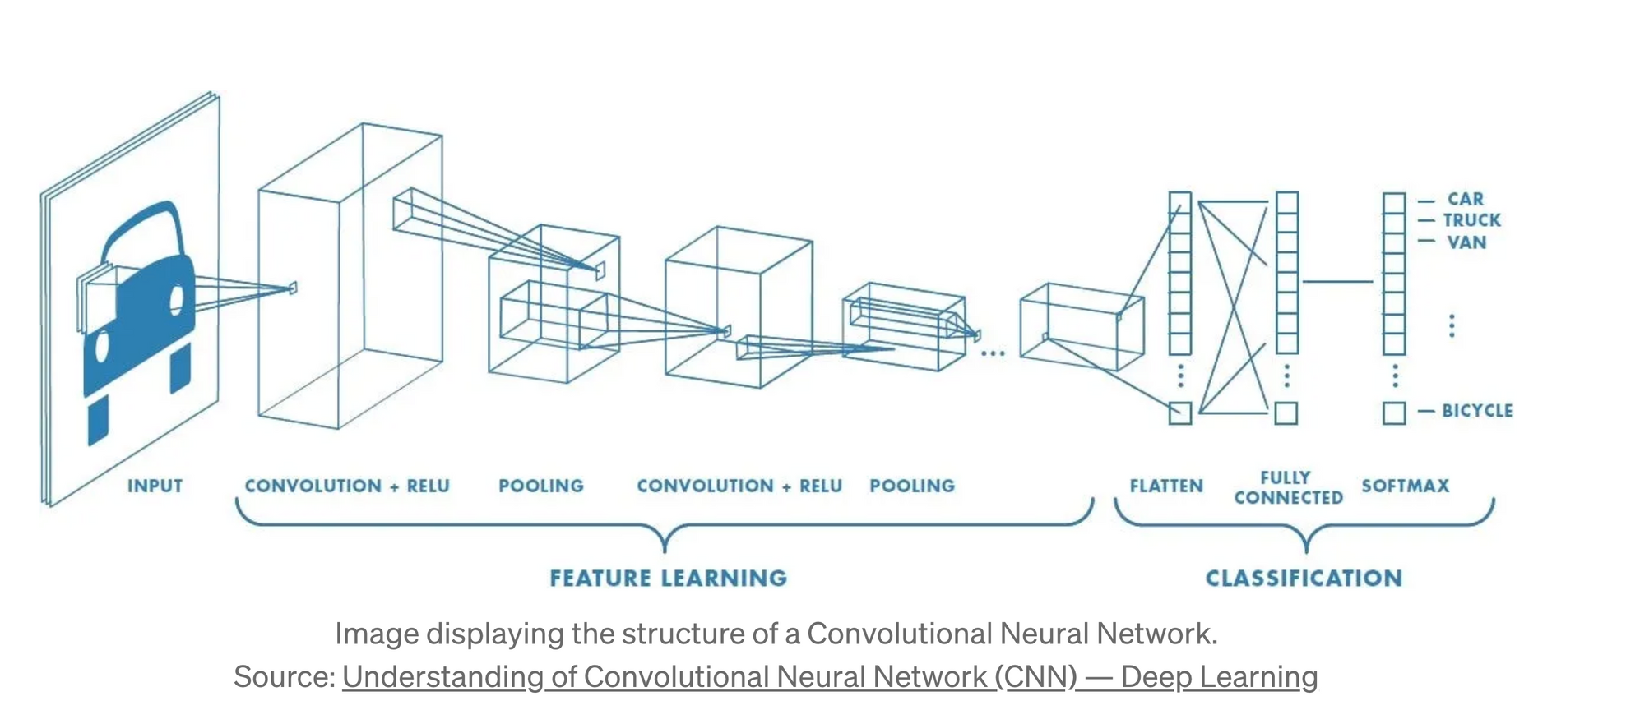

Slide 6
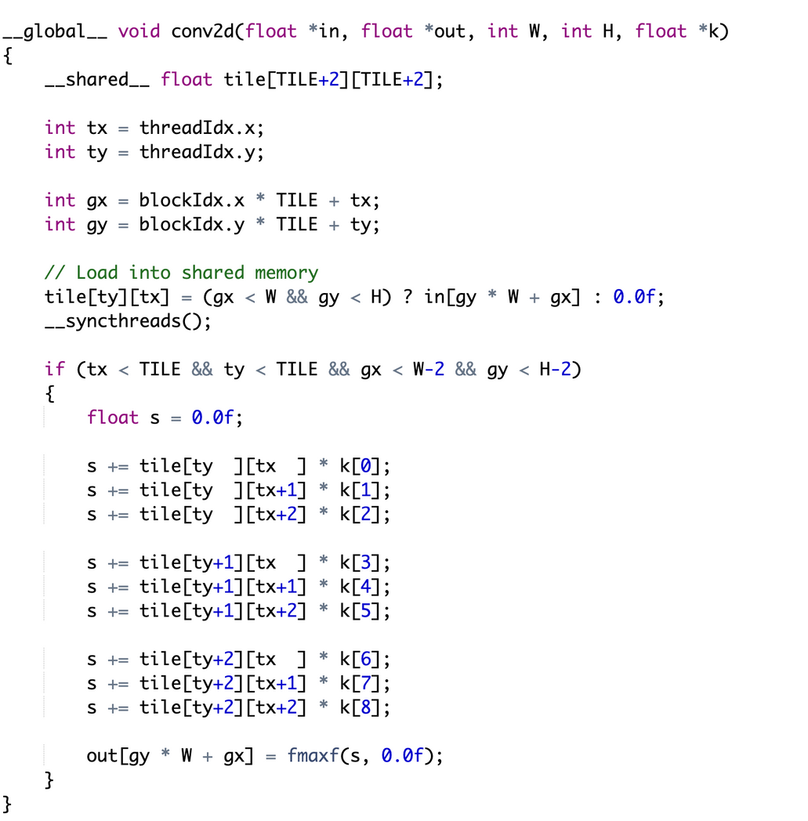
CNN Model
Convulation 2D + Relu
TILE (from shared memory)
1 0 3
5 5 8
9 2 0 Dot product of Tile* Filter
Relu = Max(0,x)
FILTER (weights) Relu: Max(1,0,3)= [1,3]
1 0 -1
1 0 -1
1 0 -1

Slide 7
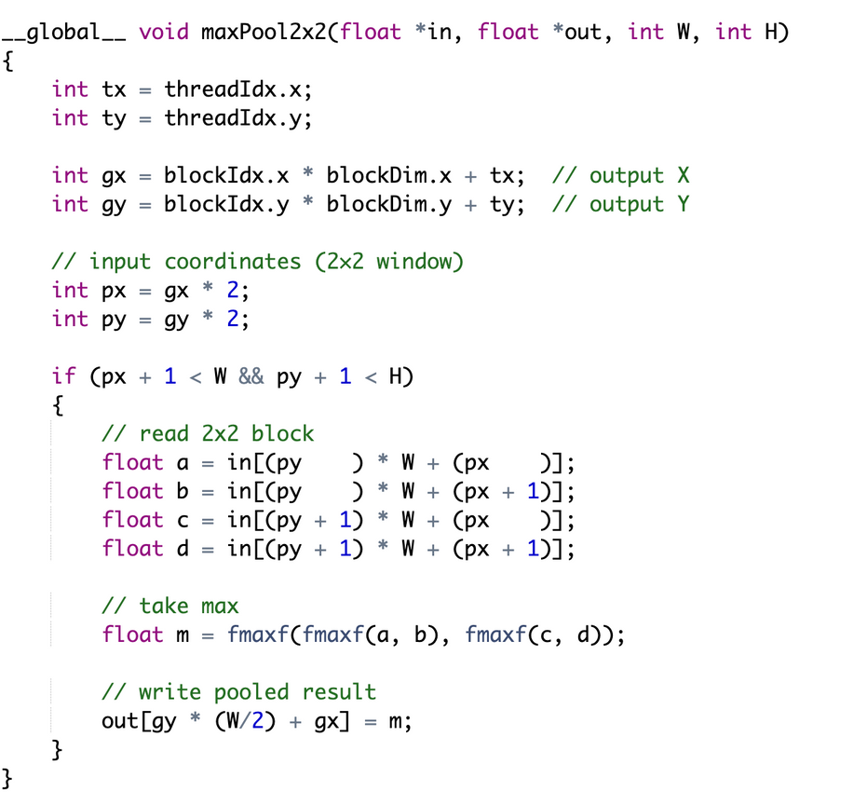
CNN Model
MaxPolling
Max Pooling reduces the spatial size by taking the maximum value from each region.
2 5 1 0
3 8 2 1
0 4 9 2 [2 5]
[3 8] → max = 8
[1 0]
[2 1] → max = 2

Slide 8
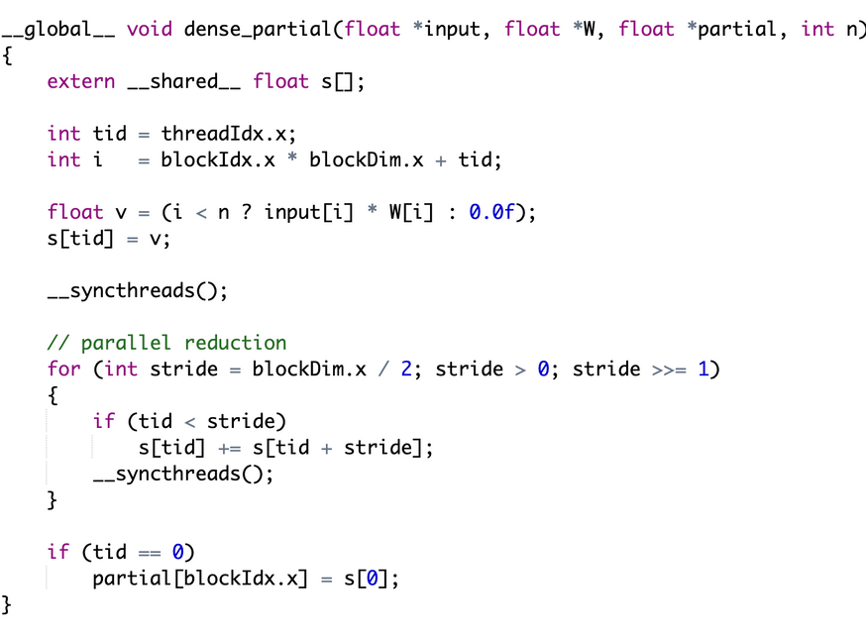
CNN Model
Flattern and Dense
After Maxpooling:
x(input vector) = [ 2, 4, 1, 3 ]
[ 4, 5, 4, 3 ]
[ 9, 5, 2, 8 ]
W = [ w0, w1, w2, w3 ](Weight Vector)
Flattern =[ 2, 4, 1, 3, 4, 5, 4, 3, 9, 5, 2,8 ]
Dense Layer : [2 × w0 + 4 × w1+1 × w2+3 × w3...](Reduction is done in parallel)

Slide 9
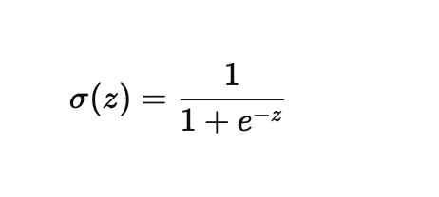
CNN Model
Sigmoid Function:
Sigmoid converts the Dense layer output z into a probability: 0 ≤ σ (z) ≤ 1
Sigmoid Formula :
After Flattern and Dense : [8, 1, 2, -2, 8, 4, 7, 0..]
If Input : 8 → (0.977) Dog (1)
If Input : -2 → (0.119) Cat (0)

Slide 10
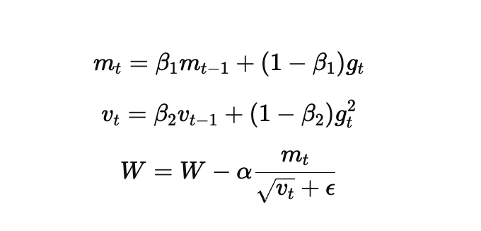
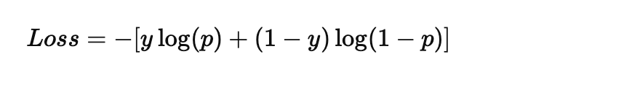
Training process
Adam Optimizer (GPU Parallel Update) : Adam uses momentum + RMS to update weights.
Binary Cross Entropy Loss :
Accuracy Calculation: Count correct predictions
Accuracy Calculation

Slide 11
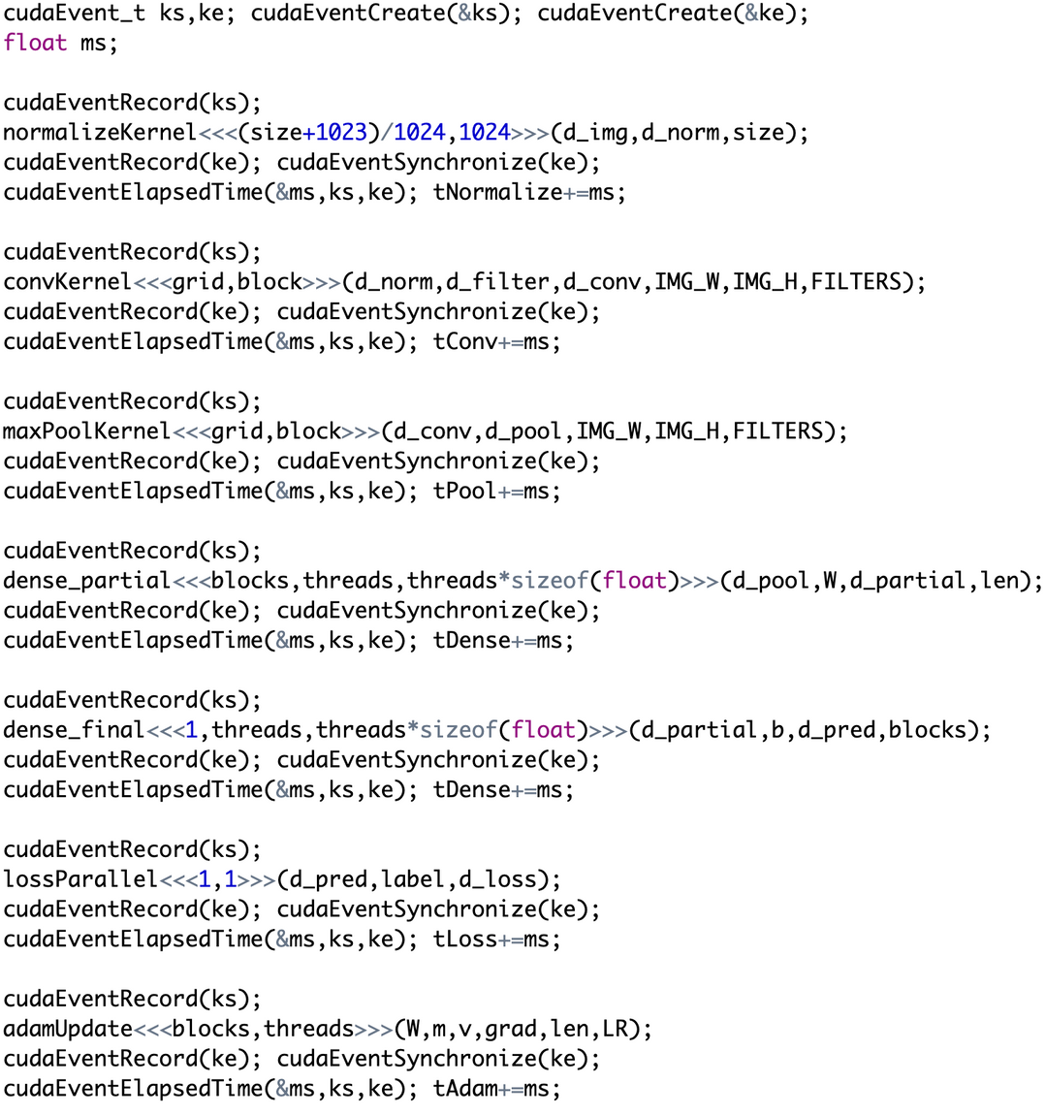
Timing
Each CUDA kernel was timed using cudaEventRecord() cudaEventElapsedTime()
Normalize
Convolution
MaxPool
Dense
Loss
and Adam.
All kernel times are accumulated to get the final GPU timing summary

Slide 12
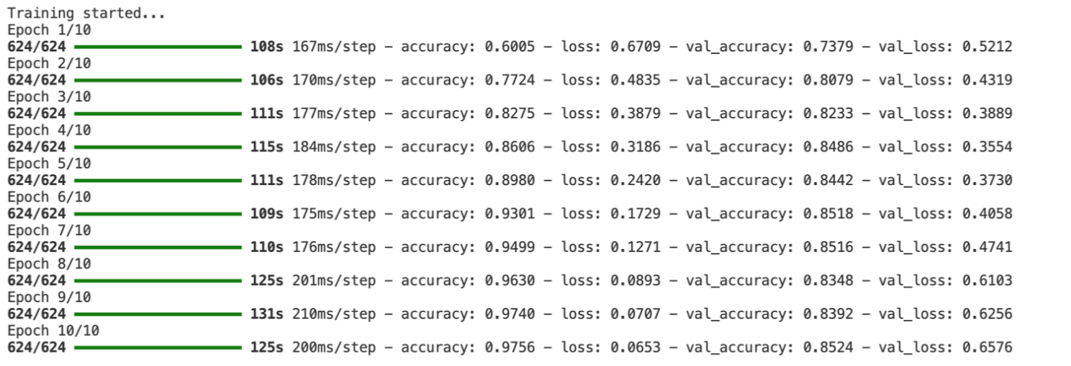
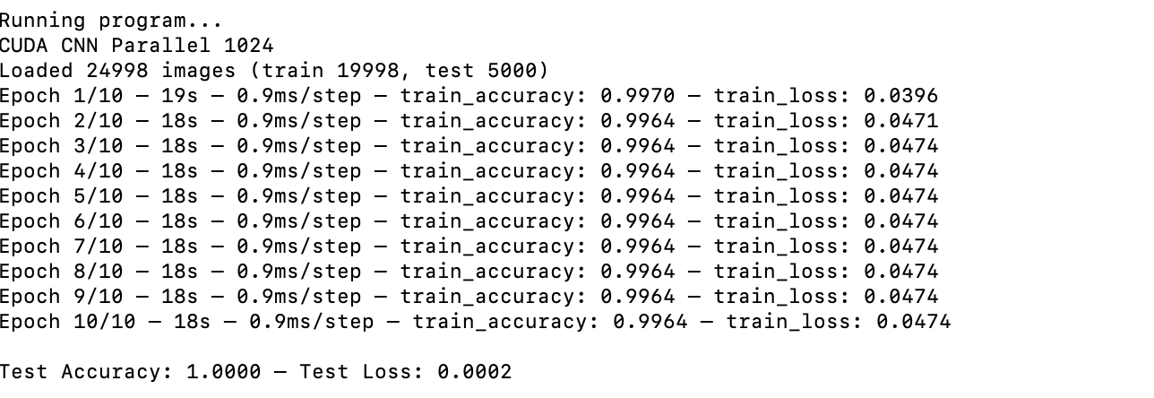
Performance analysis(CPU vs GPU)
Sequential(CPU)
Parallel(GPU)

Slide 13
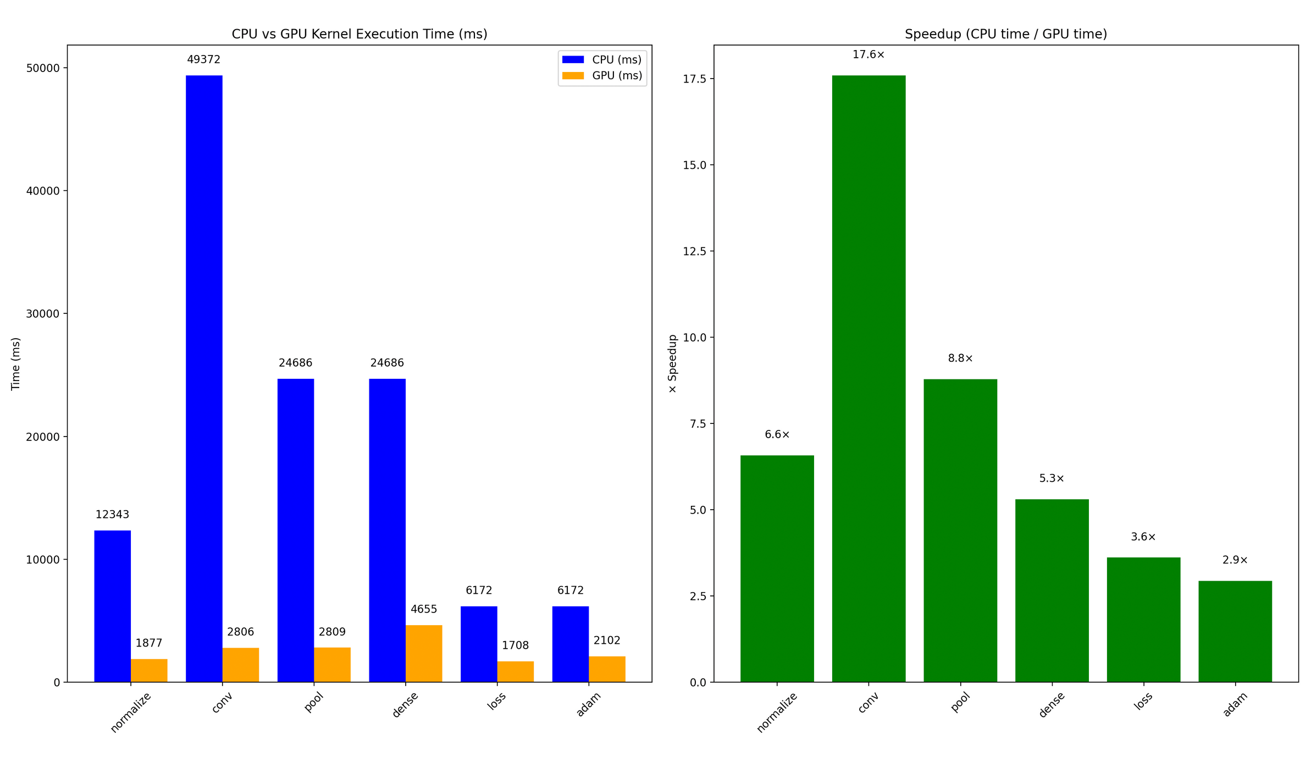
Performance analysis (CPU vs GPU)

Slide 14
cited:
stb_image.h (image loading library): https://github.com/nothings/stb
baseline python Project: https://github.com/Shishirise/ML-with-Python/tree/main/Project%201
ChatGPT : https://chat.openai.com/
Cats vs Dogs – Kaggle Dataset: https://www.kaggle.com/datasets/bhavikjikadara/dog-and-cat-classification-dataset
Documentation: Kirk, David B., and Wen-mei W. Hwu. Programming Massively Parallel Processors: A Hands-on Approach. 3rd ed., Morgan Kaufmann, 2017.

